Slide 1
Reinforcement Learning-Based Bit-Flipping Decoding Strategy for Channel Coding
Error Control Coding for Communication and Computers (EECE 571E) Project
Idan Roth | Flynn Dowey | Cee Rikhh

Slide 2
Overview
Decoding Error Correcting Codes conceptualized as a classification problem
Tackled using Reinforcement Learning (RL)
Binary linear codes considered
Iterative decoding via individual Bit-Flipping (BF) decisions
Can be formulated as a Markov Decision Process (MDP)
Syndromes-based approach
State Space of MDP has all binary syndromes

Slide 3
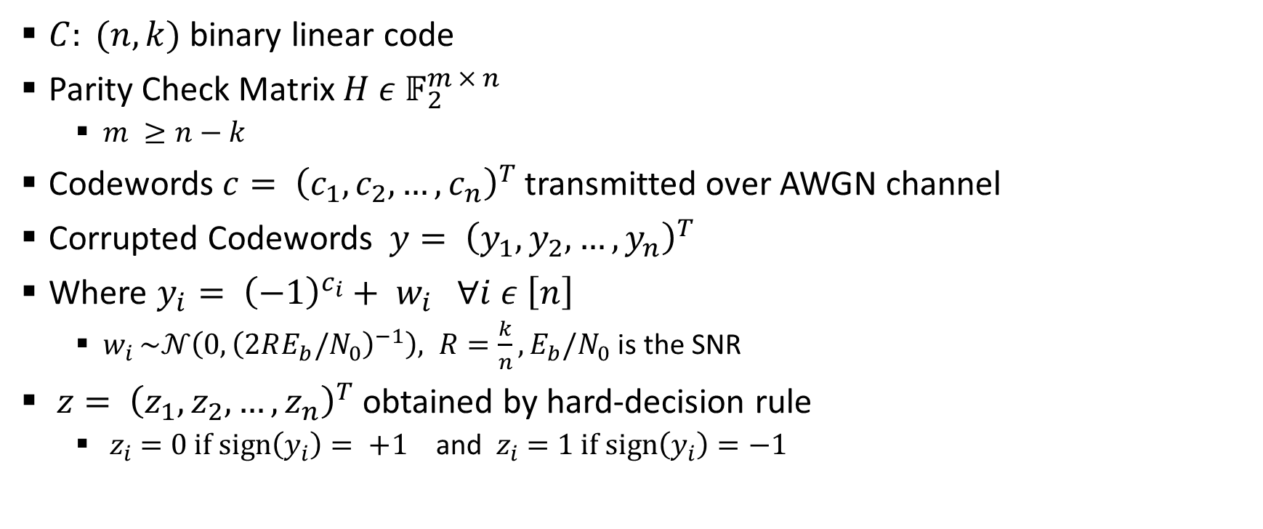
Channel Coding Background
$C: (n,k)$ binary linear code
Parity Check Matrix $H ε 𝔽_{2}^{m × n}$
$m ≥n−k$
Codewords $c= {\left(c_{1},c_{2}, …,c_{n}\right)}^{T}$ transmitted over AWGN channel
Corrupted Codewords $y= {\left(y_{1},y_{2}, …,y_{n}\right)}^{T}$
Where $y_{i}= {\left(−1\right)}^{c_{i}}+ w_{i} ∀i ε \left[n\right]$
$w_{i }\sim 𝒩\left(0, {\left(2RE_{b}/N_{0}\right)}^{−1}\right), R=\frac{k}{n},E_{b}/N_{0}$ is the SNR
$z= {\left(z_{1},z_{2}, …,z_{n}\right)}^{T}$ obtained by hard-decision rule
${ z}_{i} =0 if sign\left(y_{i}\right)= +1$ and ${ z}_{i} =1 if sign\left(y_{i}\right)=−1$

Slide 4
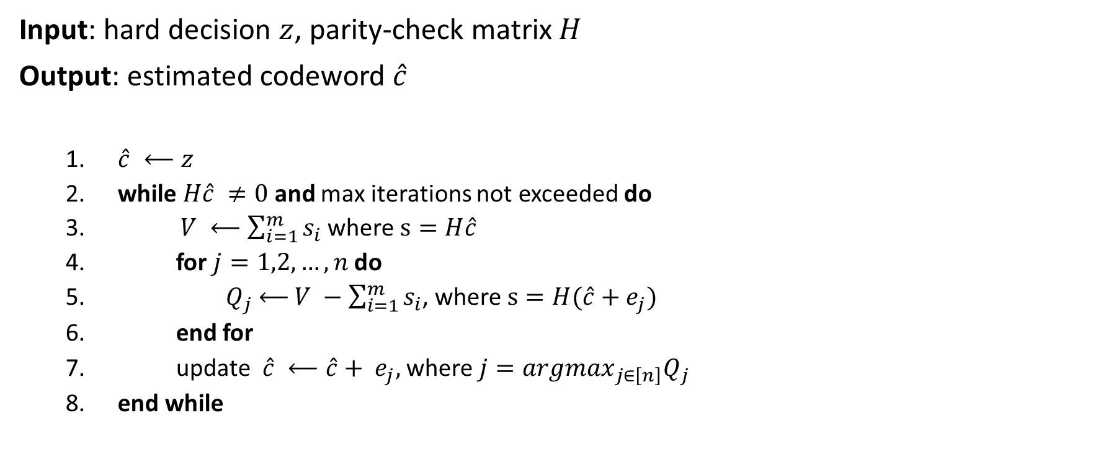
Bit-Flipping Decoding Algorithm
Input: hard decision $z$, parity-check matrix $H$
Output: estimated codeword $\hat{c}$
$\hat{c} ⟵z$
while $H\hat{c} ≠0$and max iterations not exceeded do
$V ⟵\sum_{i=1}^{m}{s_{i}}$where $s=H\hat{c}$
for $j=1,2,…, n$do
${ Q}_{j}$ $⟵$ $V −\sum_{i=1}^{m}{s_{i}}$, where $s=H(\hat{c}+e_{j})$
end for
update $\hat{c} ⟵\hat{c}+ e_{j},$ where $j={argmax}_{j∈\left[n\right]}Q_{j}$
end while

Slide 5
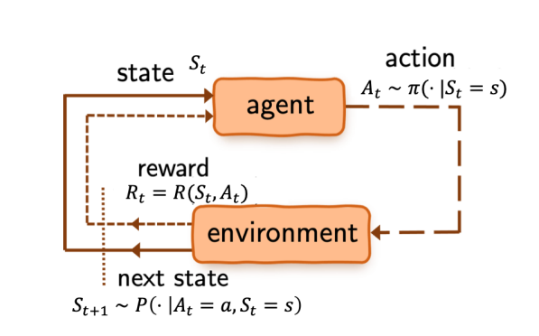
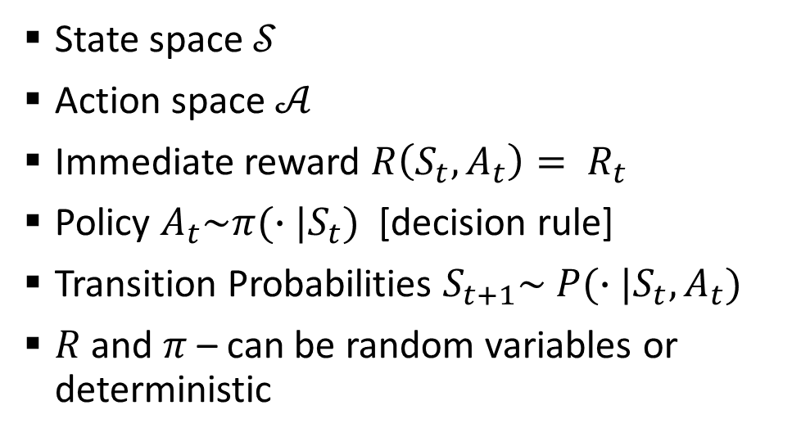
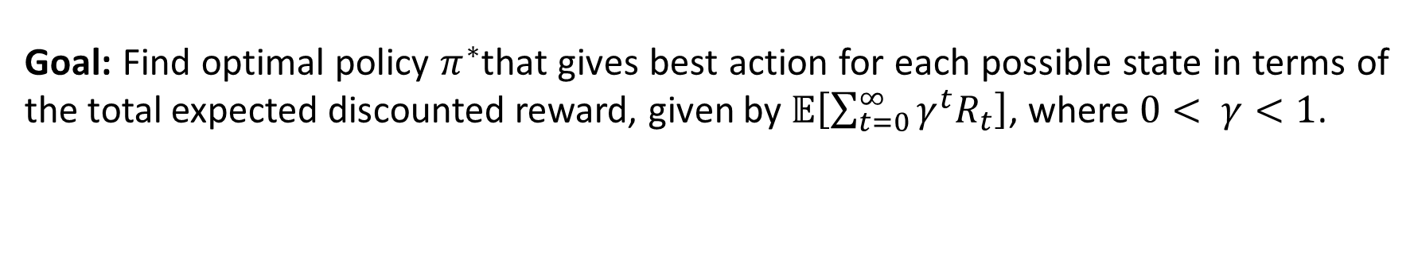
Markov Decision Process
State space $𝒮$
Action space $𝒜$
Immediate reward $R\left(S_{t},A_{t}\right)= R_{t}$
Policy $A_{t}\sim π(∙|S_{t})$ [decision rule]
Transition Probabilities $S_{t+1}\sim P(∙|S_{t},A_{t})$
$R$ and $π$ – can be random variables or deterministic
Goal: Find optimal policy $π^{∗}$that gives best action for each possible state in terms of the total expected discounted reward, given by $𝔼\left[\sum_{t=0}^{∞}{γ^{t}R_{t}}\right]$, where $0< γ<1$.

Slide 6
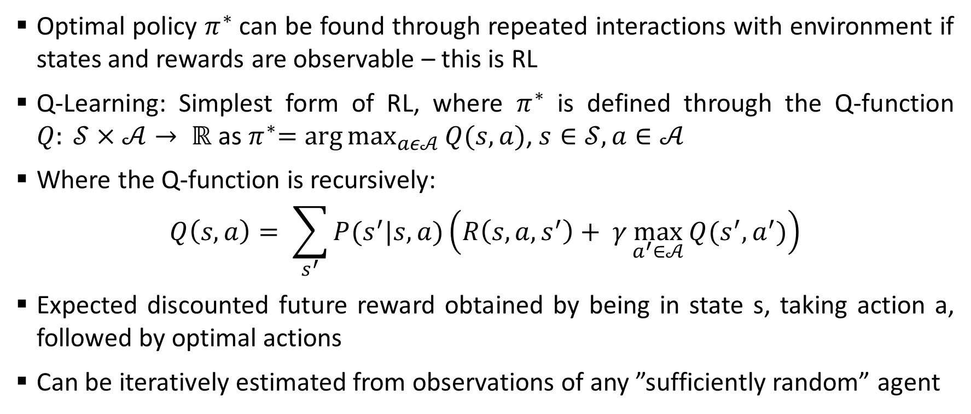
Q-Learning
Optimal policy $π^{∗}$can be found through repeated interactions with environment if states and rewards are observable – this is RL
Q-Learning: Simplest form of RL, where $π^{∗}$ is defined through the Q-function $Q: 𝒮×𝒜→ ℝ$ as${ π}^{∗}=arg\max_{aε𝒜}{Q(s,a)}$, $s∈𝒮, a∈𝒜$
Where the Q-function is recursively:
$$Q\left(s,a\right)= \sum_{s^{′}}{P(s^{′}|s,a)\left(R\left(s,a,s^{′}\right)+ γ\max_{a^{′}∈𝒜}{Q(s^{′},a^{′})}\right)}$$
Expected discounted future reward obtained by being in state s, taking action a, followed by optimal actions
Can be iteratively estimated from observations of any ”sufficiently random” agent

Slide 7
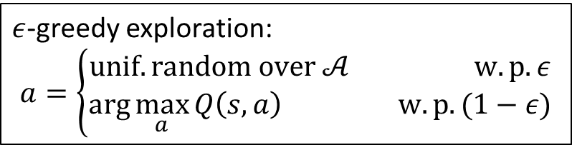
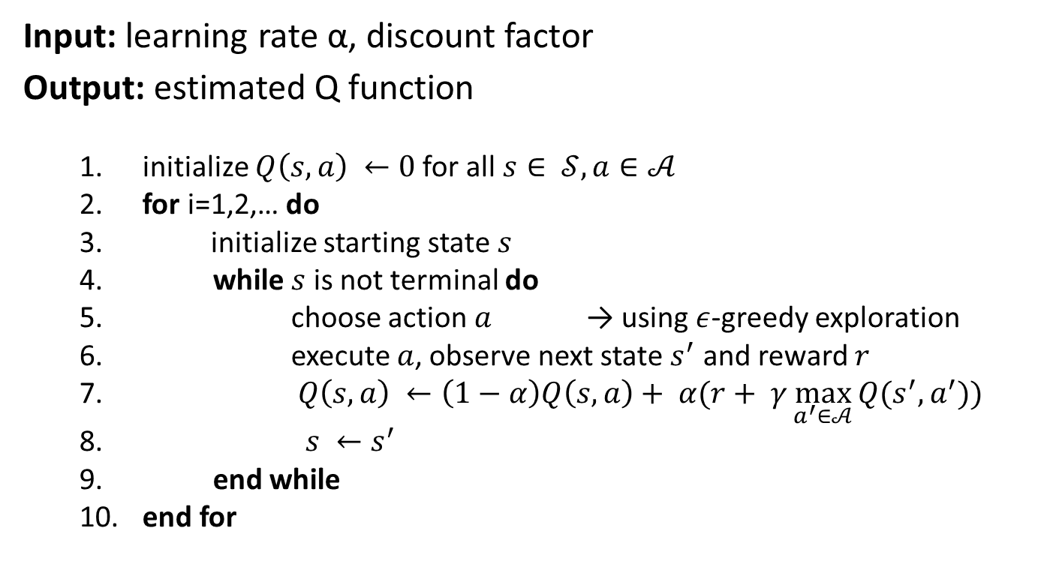
Q-Learning Algorithm
Input: learning rate α, discount factor
Output: estimated Q function
initialize $Q\left(s,a\right) ←0$for all $s∈ 𝒮, a∈𝒜$
for i=1,2,… do
initialize starting state $s$
while $s$ is not terminal do
choose action $a$ → using $ε$-greedy exploration
execute $a$, observe next state $s^{′}$ and reward $r$
$Q\left(s,a\right) ←\left(1−α\right)Q\left(s,a\right)+ α(r+ γ\max_{a^{′}∈𝒜}{Q(s^{′},a^{′}))}$
$s ←s^{′}$
end while
end for
$ε$-greedy exploration:
$$a=\left\{\begin{aligned}unif. random over 𝒜 w.p. ε \\ arg\max_{a}{Q\left(s,a\right) } w.p. (1−ε)\end{aligned}\right.$$

Slide 8
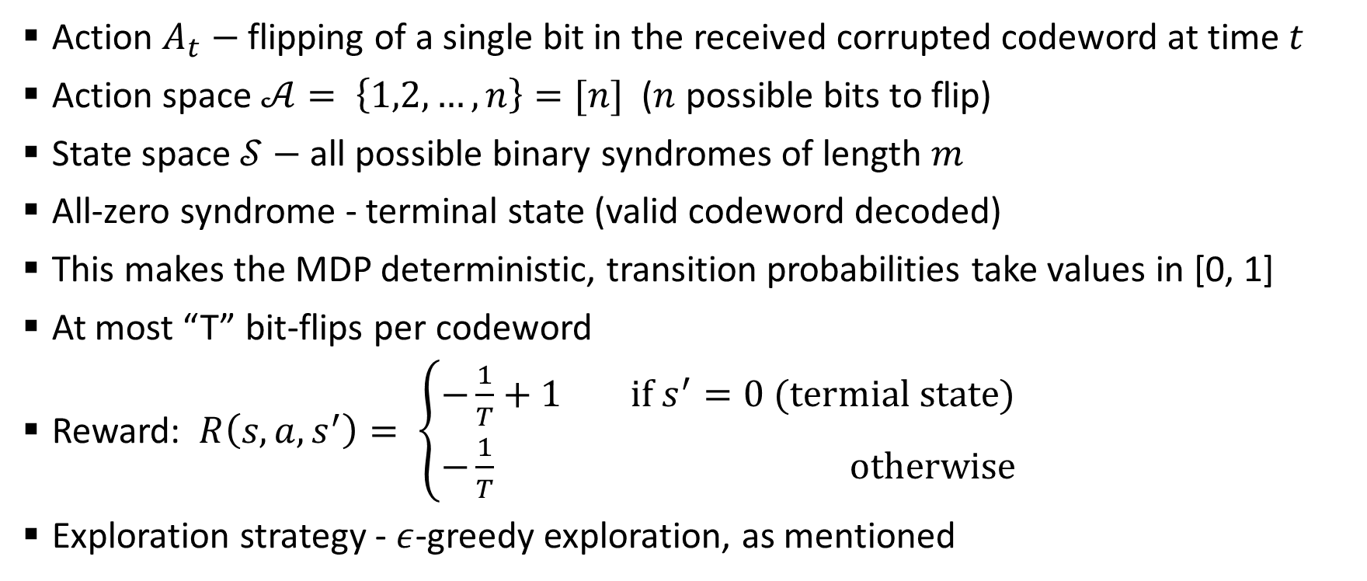
MDP Modeling
Action $A_{t}−$ flipping of a single bit in the received corrupted codeword at time $t$
Action space $𝒜= \left\{1,2,…,n\right\}=[n]$ ($n$ possible bits to flip)
State space $𝒮−$ all possible binary syndromes of length $m$
All-zero syndrome - terminal state (valid codeword decoded)
This makes the MDP deterministic, transition probabilities take values in [0, 1]
At most “T” bit-flips per codeword
Reward: $R\left(s,a,s^{′}\right)= \left\{\begin{aligned}−\frac{1}{T}+1 if s^{′}=0 (termial state) \\ −\frac{1}{T} otherwise\end{aligned}\right.$
Exploration strategy - $ε$-greedy exploration, as mentioned

Slide 9
Simulation Results

Slide 10
Conclusions

Slide 11
References
[1] A. Bennatan, Y. Choukroun, and P. Kisilev, “Deep learning for decoding of linear codes-a syndrome-based approach,” in 2018 IEEE International Symposium on Information Theory (ISIT), pp. 1595–1599, IEEE, 2018.
[2] T. Gruber, S. Cammerer, J. Hoydis, and S. Ten Brink, “On deep learningbased channel decoding,” in 2017 51st annual conference on information sciences and systems (CISS), pp. 1–6, IEEE, 2017.
[3] H. Kim, Y. Jiang, R. Rana, S. Kannan, S. Oh, and P. Viswanath, “Communication algorithms via deep learning,” arXiv preprint arXiv:1805.09317, 2018.
[4] E. Nachmani, Y. Be’ery, and D. Burshtein, “Learning to decode linear codes using deep learning,” in 2016 54th Annual Allerton Conference on Communication, Control, and Computing (Allerton), pp. 341–346, IEEE, 2016.
[5] T. O’shea and J. Hoydis, “An introduction to deep learning for the physical layer,” IEEE Transactions on Cognitive Communications and Networking, vol. 3, no. 4, pp. 563–575, 2017.
[6] R. Raheli, H. D. Pfister, C. Hager, M. Martal ¨ o, and F. Carpi, “Exploring ` machine learning algorithms for decoding linear block codes,” 2018.
[7] L. Tallini and P. Cull, “Neural nets for decoding error-correcting codes,” in IEEE Technical applications conference and workshops. Northcon/95. Conference record, p. 89, IEEE, 1995.
[8] F. Carpi, C. Hager, M. Martal ¨ o, R. Raheli, and H. D. Pfister, “Rein- ` forcement learning for channel coding: Learned bit-flipping decoding,” in 2019 57th Annual Allerton Conference on Communication, Control, and Computing (Allerton), pp. 922–929, IEEE, 2019.
[9] V. Guruswami, A. Rudra, and M. Sudan, “Essential coding theory,” Draft available at http://www. cse. buffalo. edu/atri/courses/codingtheory/book, vol. 2, no. 1, 2012.
[10] C. J. C. H. Watkins, “Learning from delayed rewards,” 1989.

